Slide 1

HANDS ON
GEN AI

Slide 2
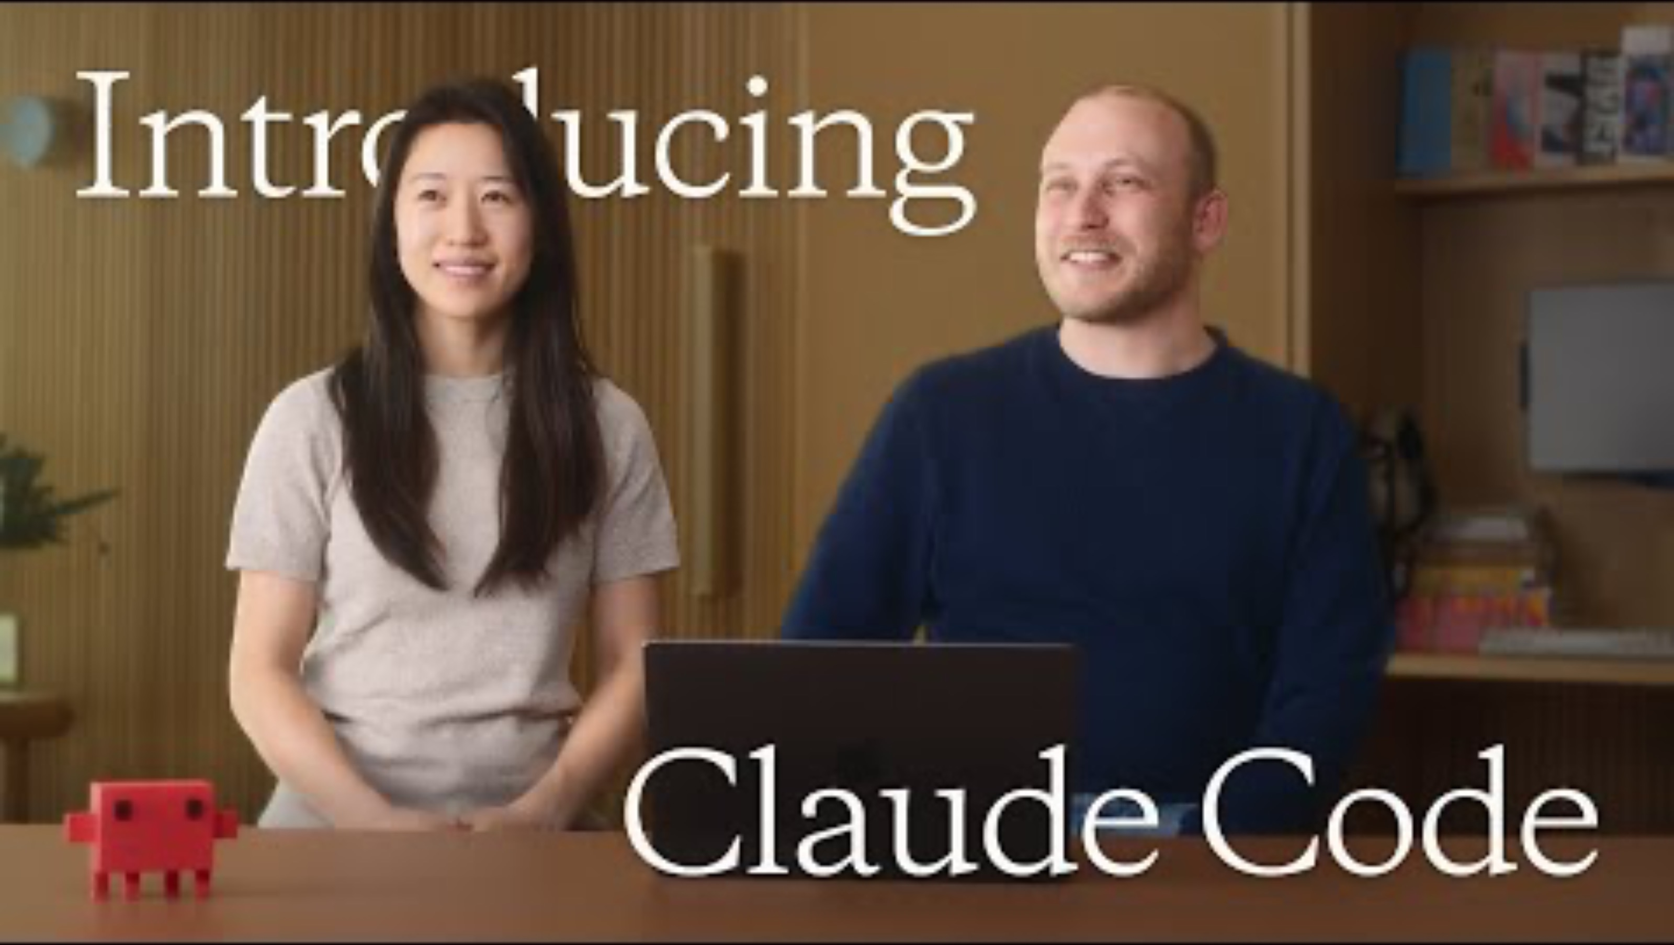
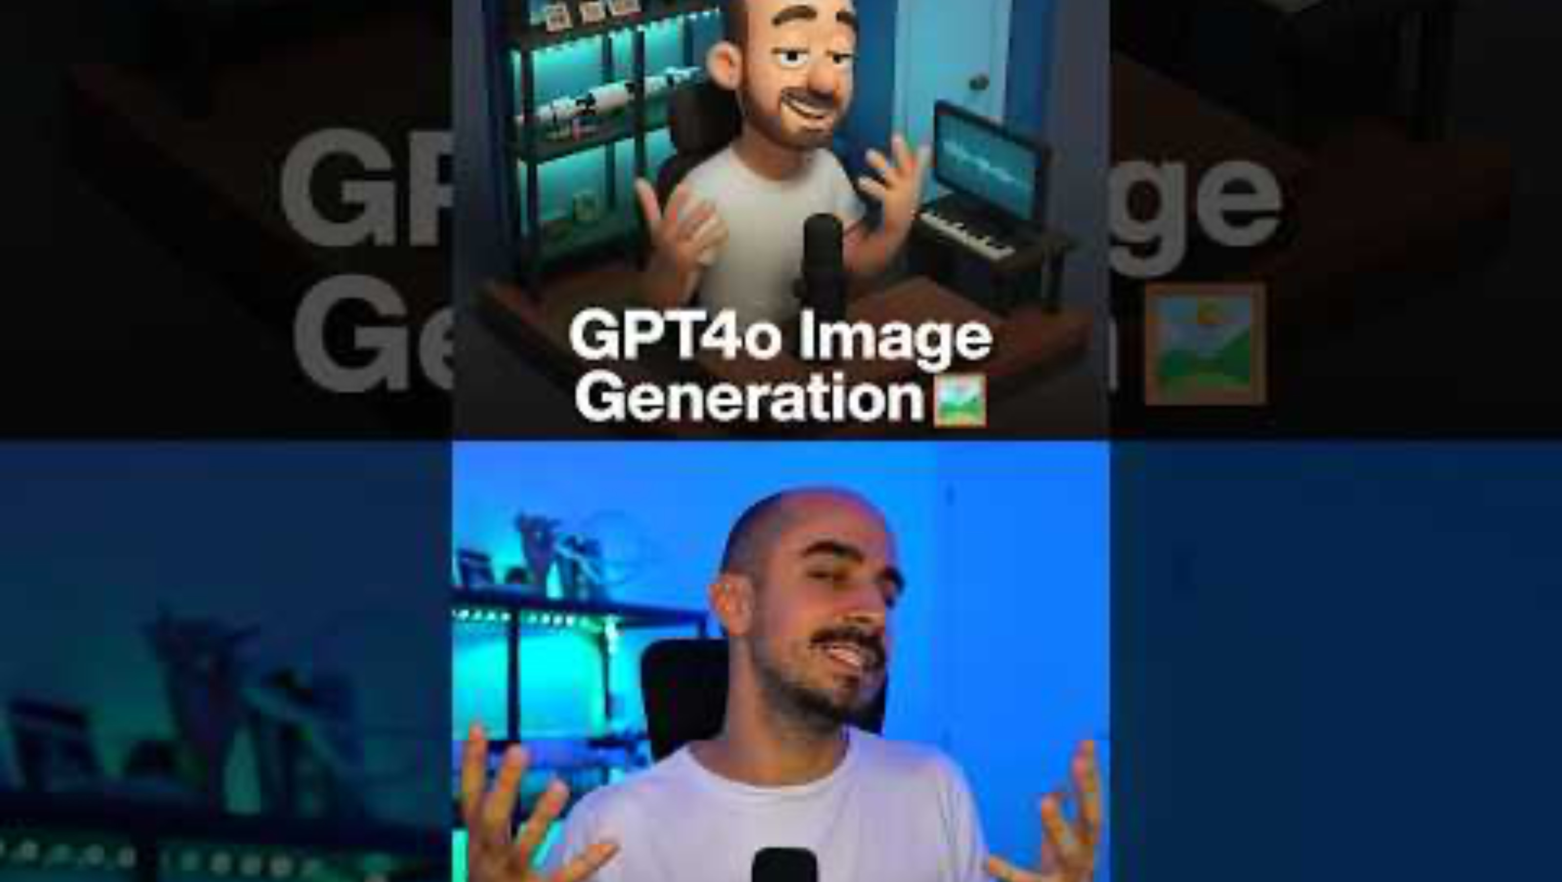
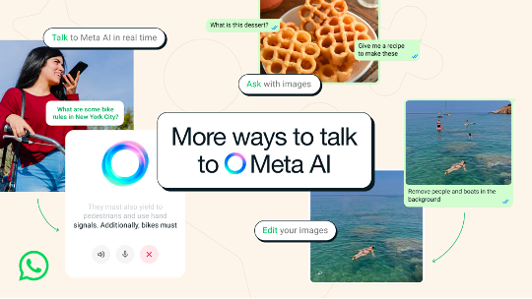

DO YOU KNOW EVERYTHING GENERATIVE AI CAN ALREADY CREATE?

Slide 3
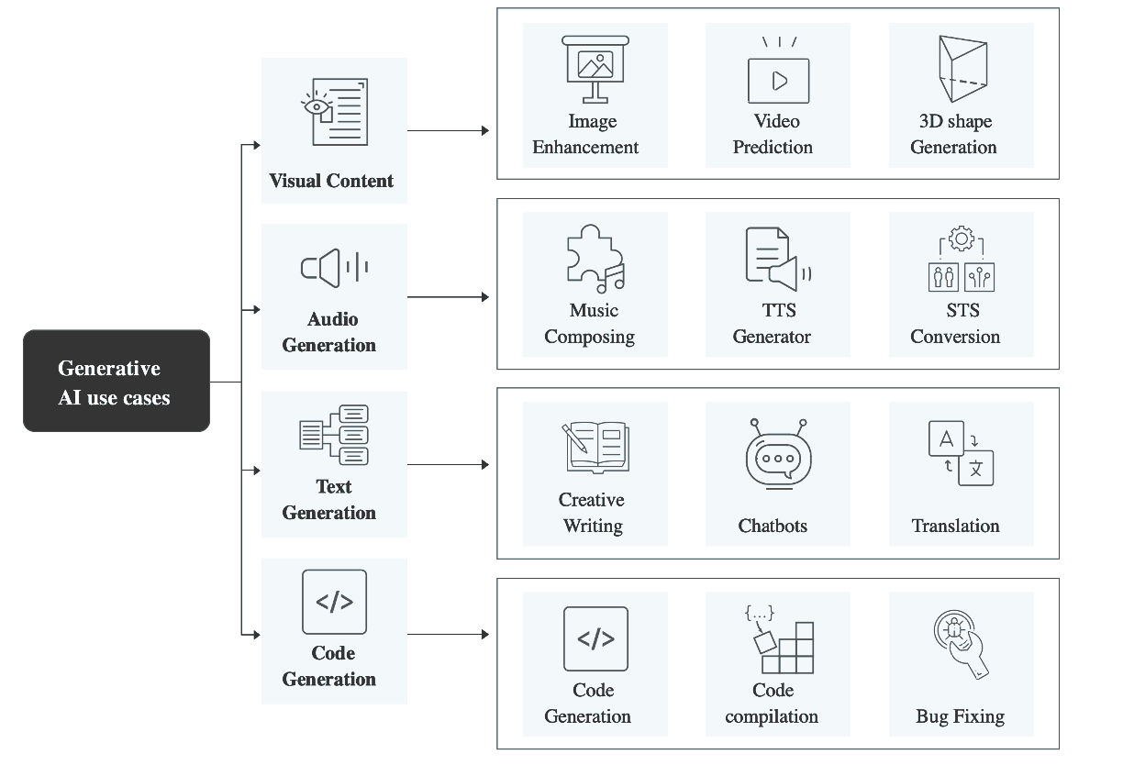

USES AND APPLICATIONS

Slide 4
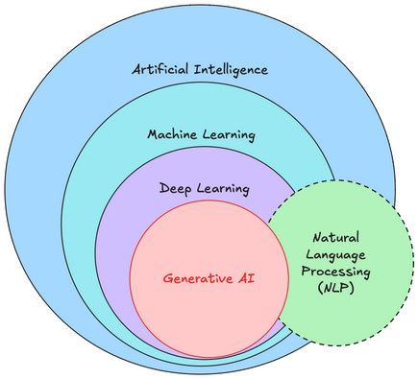
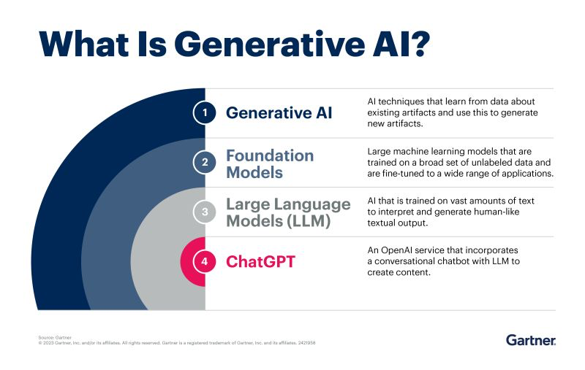
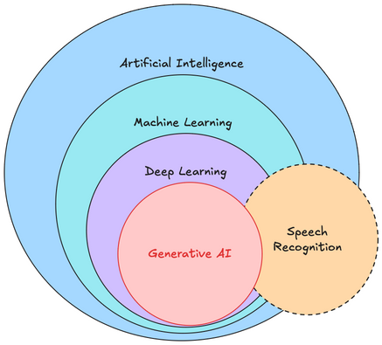

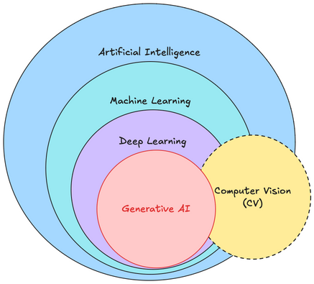

UNTANGLING THE MAP OF ARTIFICIAL INTELLIGENCE

Slide 5
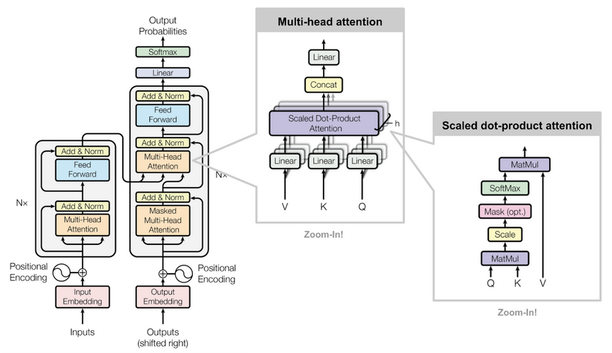


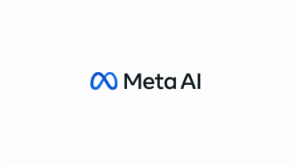





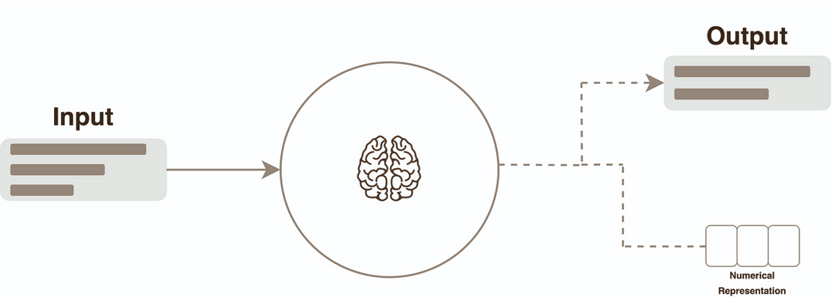
LARGE LANGUAGE MODELS (LLM)
Attention is all you need
Transformers, ushering in a new era, use attention mechanisms to predict more accurately than RNN-based models. They are transforming the future of technology.

Slide 6
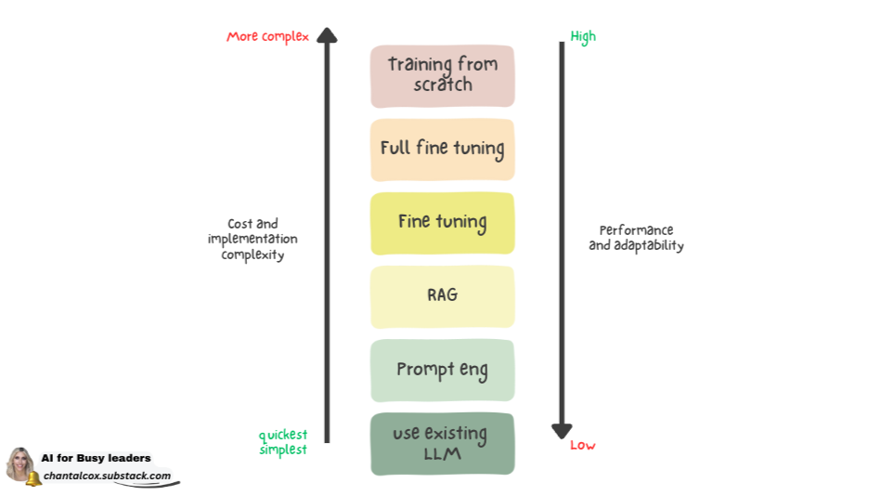

LARGE LANGUAGE MODELS (LLM)
PROMPT
A question or instruction you give to an AI model
PARAMETERS
Settings or values that control how the AI responds to a prompt (e.g temperature, max_tokens, top_p)
LLM

Slide 7
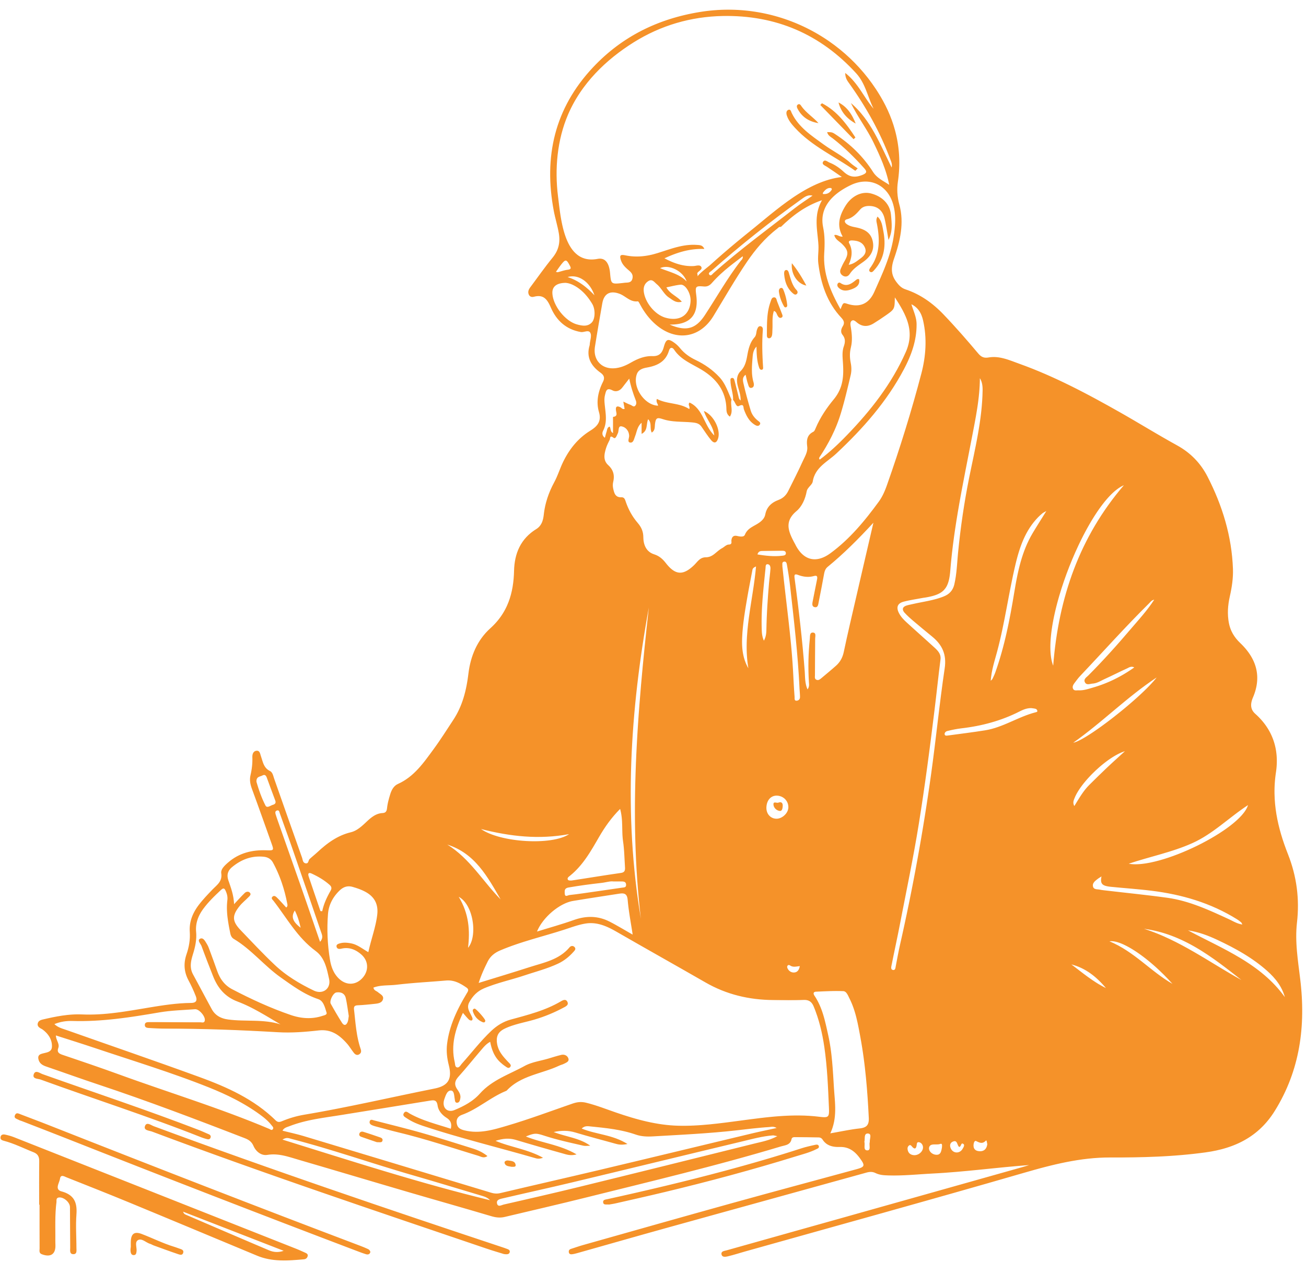
PROMPT ENGINEERING
ZERO SHOT
No examples provided to LLM to respond to your request. LLM is expected to know the answer.
FEW SHOT
Few examples or prompt provided to LLM to understand what is the expected/ideal response.
CHAIN OF THOUGHT
Provide reasoning through intermediate steps to LLMs. Extension of few shot and logical flow.

Slide 8
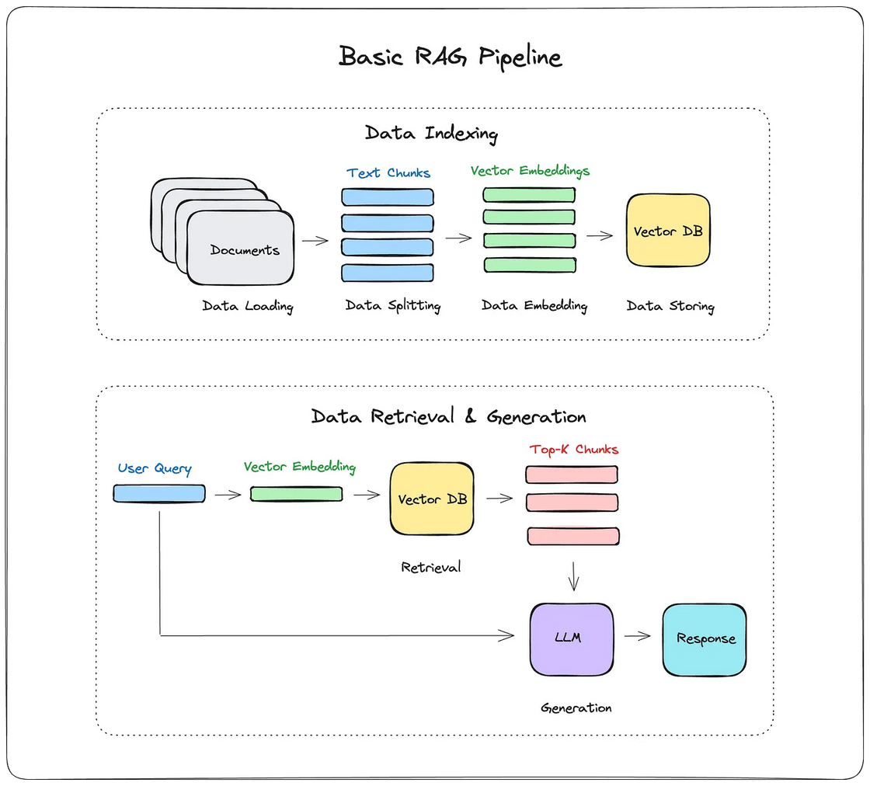


RETRIEVAL AUGMENTED GENERATION

Slide 9
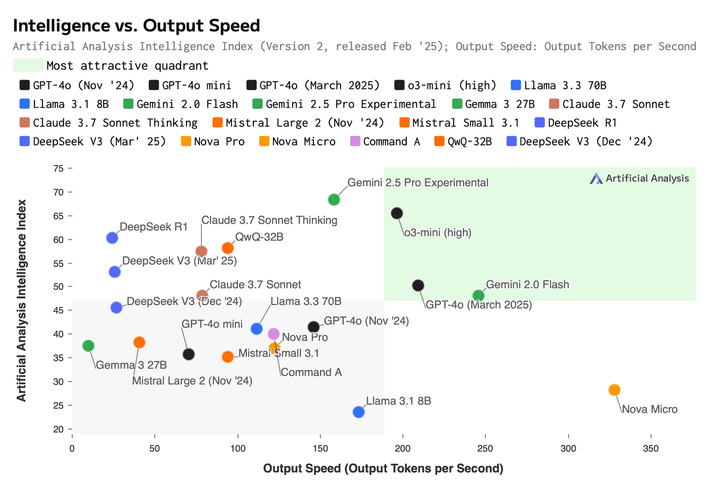
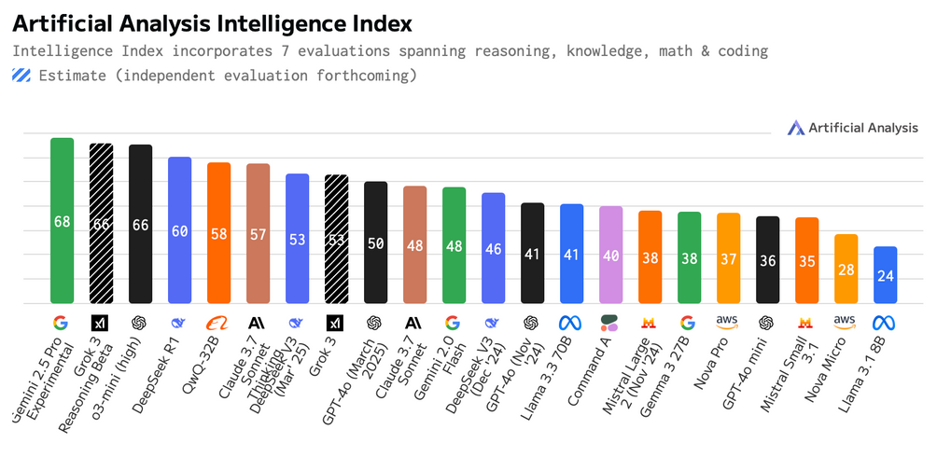

LARGE LANGUAGE MODELS (LLM)
Artificial Analysis

Slide 10
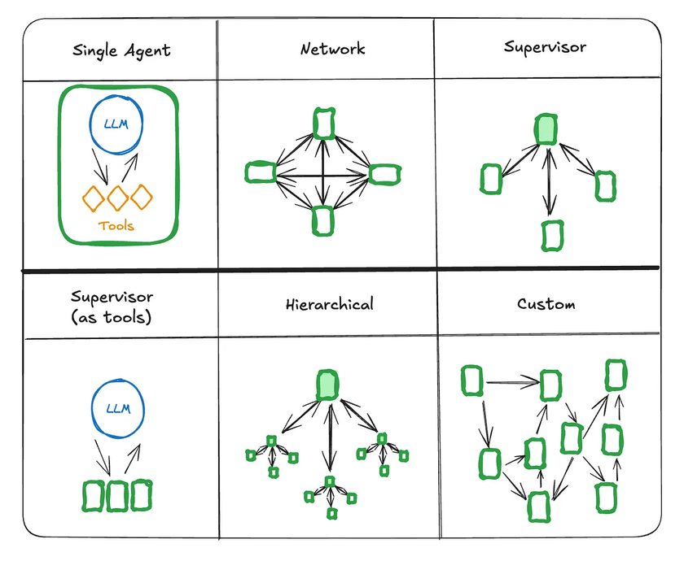
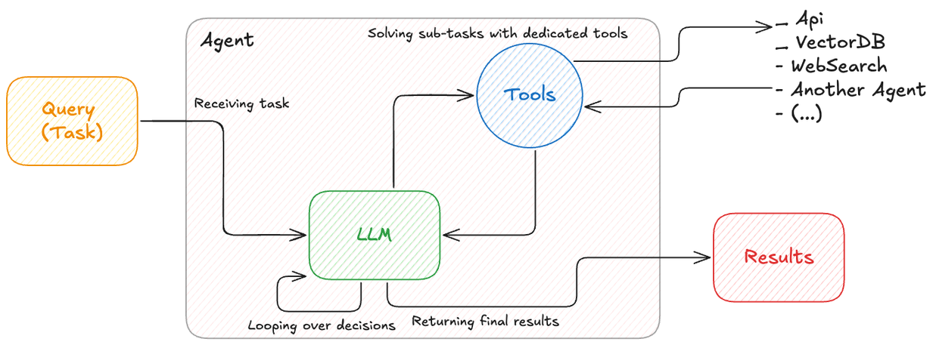


AI AGENTS

Slide 11

Thank you for your attention!
Now, let's dive into the fun!

